Slide 1
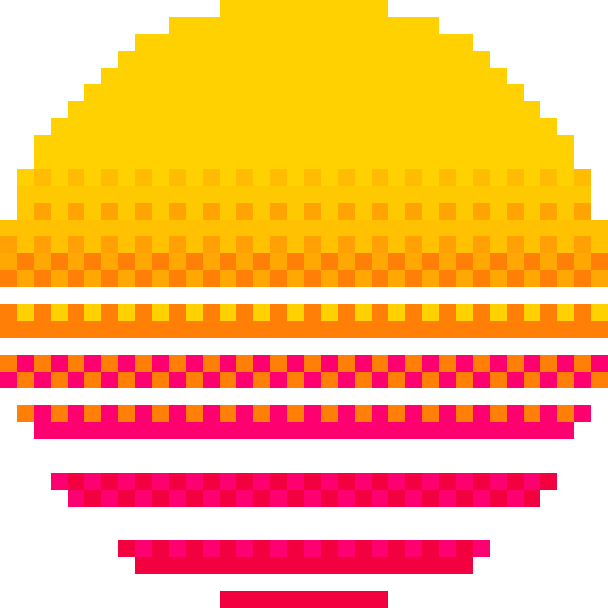
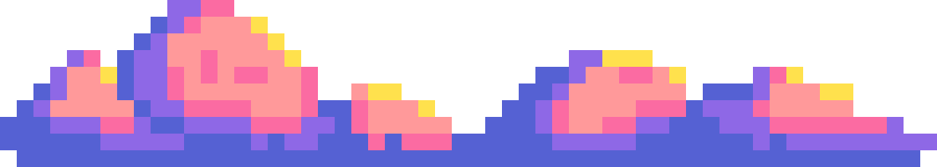
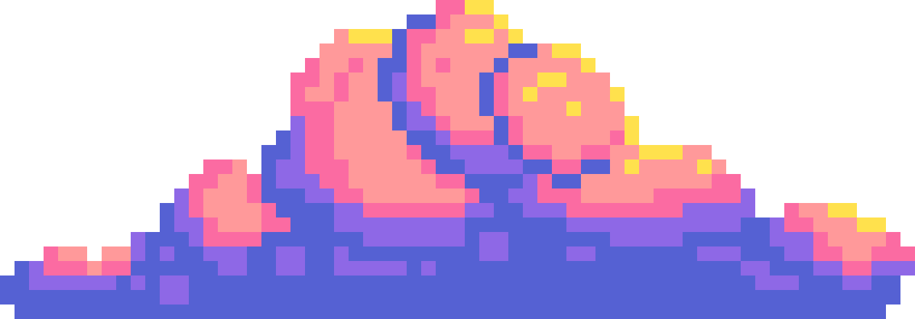
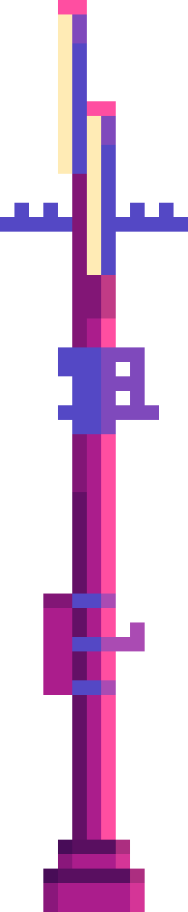
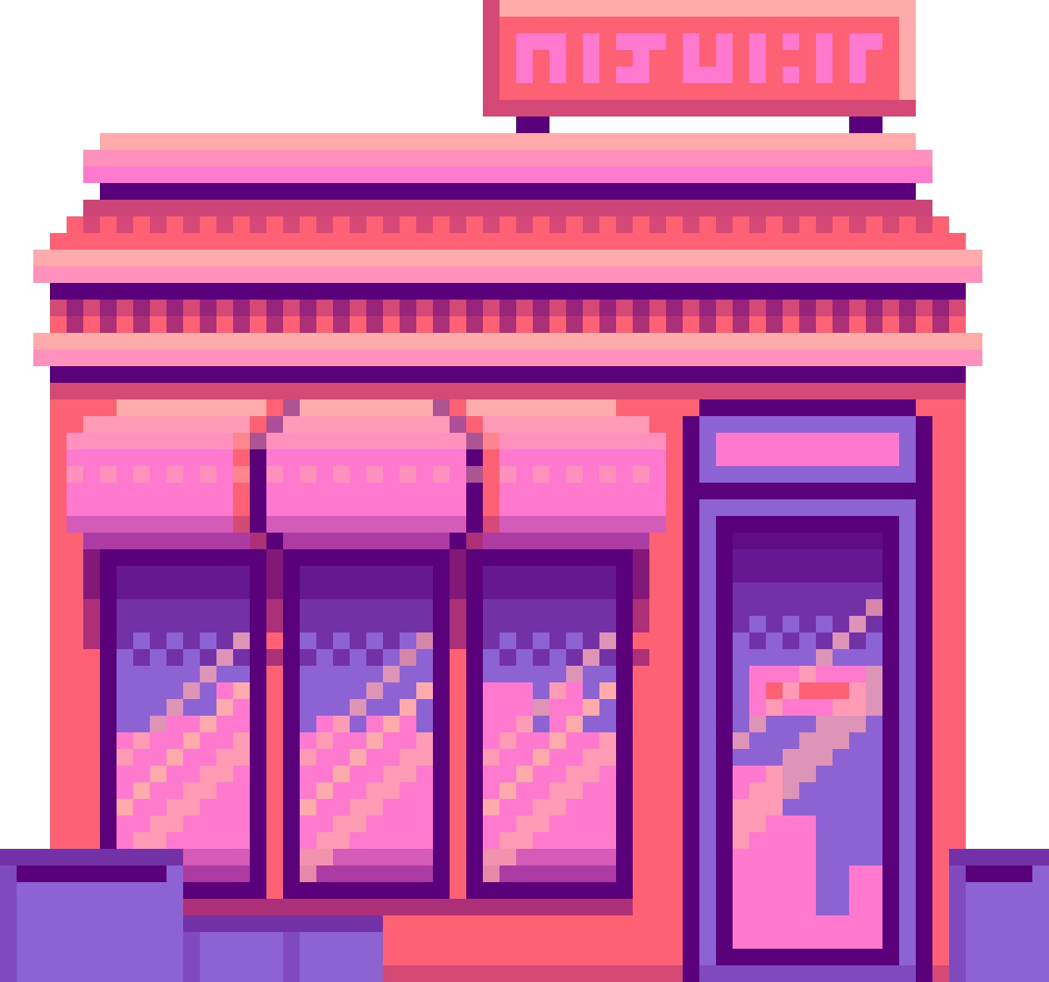
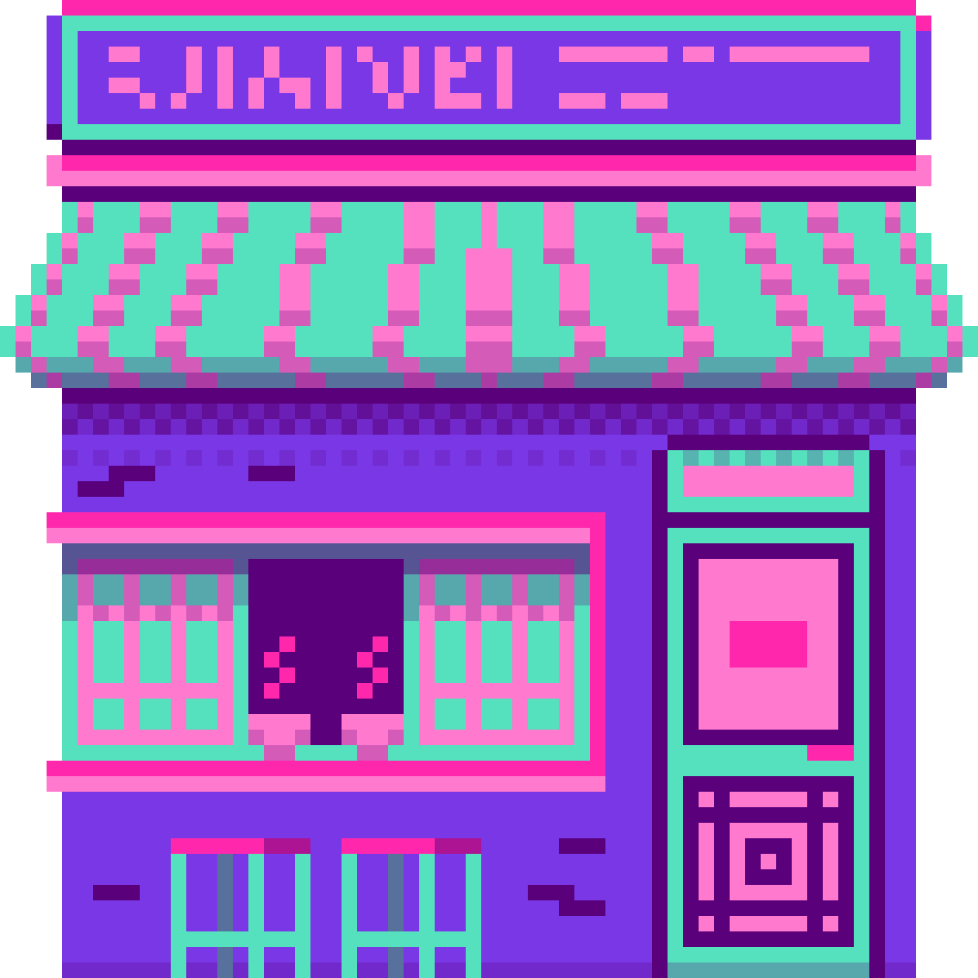
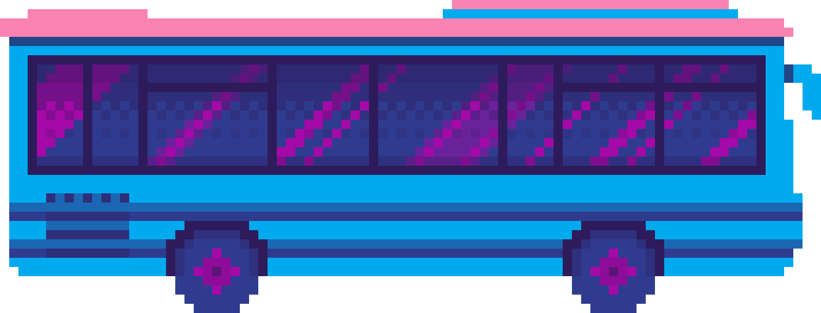
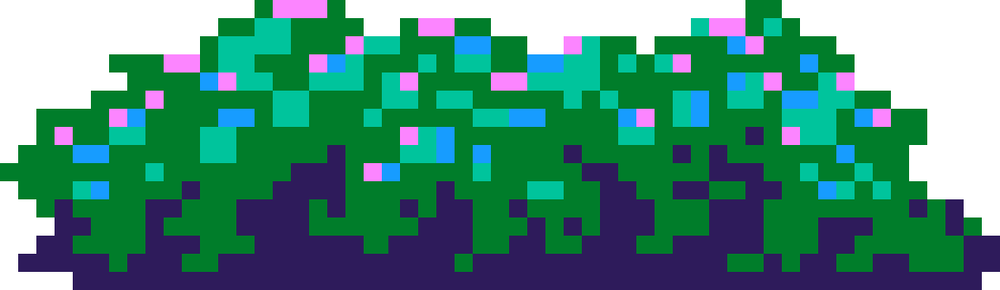
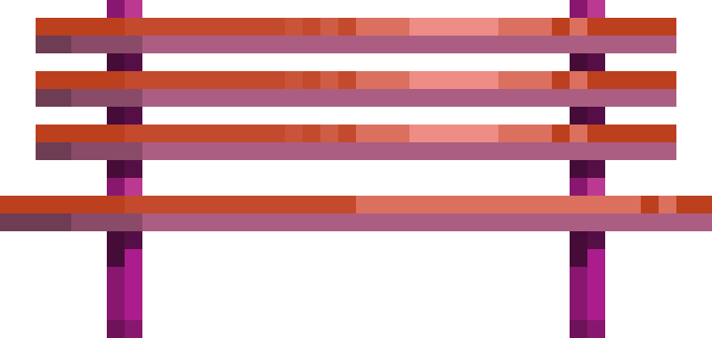
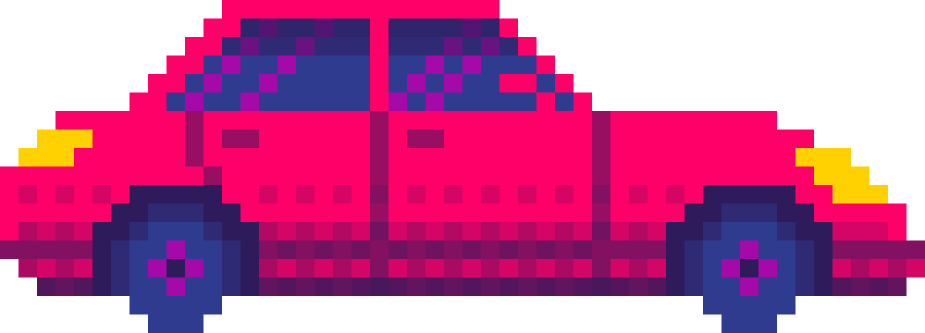
RANDOM WORLD GENERATION

Slide 2
INTRODUCTION :
Random world generation algorithms play a crucial role in various fields, including gaming, simulation, procedural content generation, and data visualization.
As games became more complex and ambitious, developers faced challenges in creating expansive and diverse virtual worlds manually

Slide 3
SOME COMMON PROBLEMS :
Limited Memory and Storage
Player Expectations
Handcrafted Content
Dynamic Environments
Randomization for Replayability

Slide 4
SOME ALGORITHMS
Perlin Noise and Simplex Noise
Cellular Automata
Voronoi diagrams
Biome Assignment
Whittaker Diagram
Cave and Dungeon Generation

Slide 5
NOISE
Noise in the context of computer graphics and procedural content generation refers to random or pseudo-random variations that are added to signals or data to create naturalistic or visually interesting effects.
Way too TECHNICAL!!!
Noise is just a way to add a bit of randomness or variation to make things look more realistic and interesting..
For e.g. Think of a smooth, perfectly straight line. It's nice, but it might look a bit too perfect, like it was drawn with a ruler. Now, if we add a little bit of noise to that line, it becomes a bit wavy or irregular, more like something we might see in nature.

Slide 6
Perlin Noise
Perlin noise is a type of gradient noise for creating natural-looking textures and terrain in computer graphics.
Imagine you're drawing a landscape with hills and valleys on a piece of paper. Instead of drawing each hill and valley perfectly, you want to add some randomness to make it look more natural.
Perlin noise helps you do that !!

Slide 7
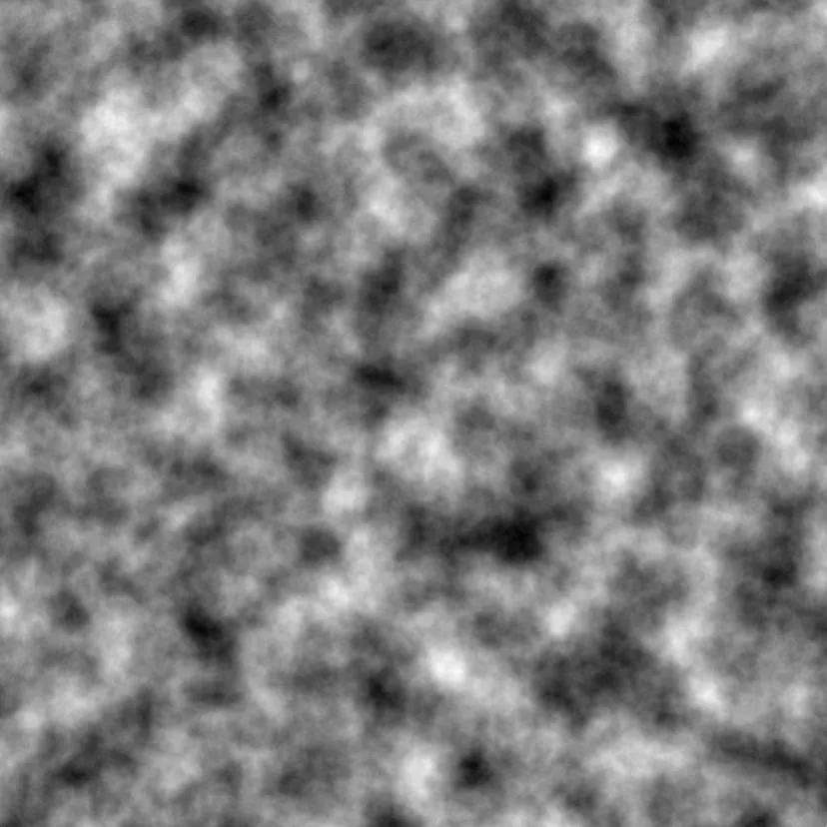
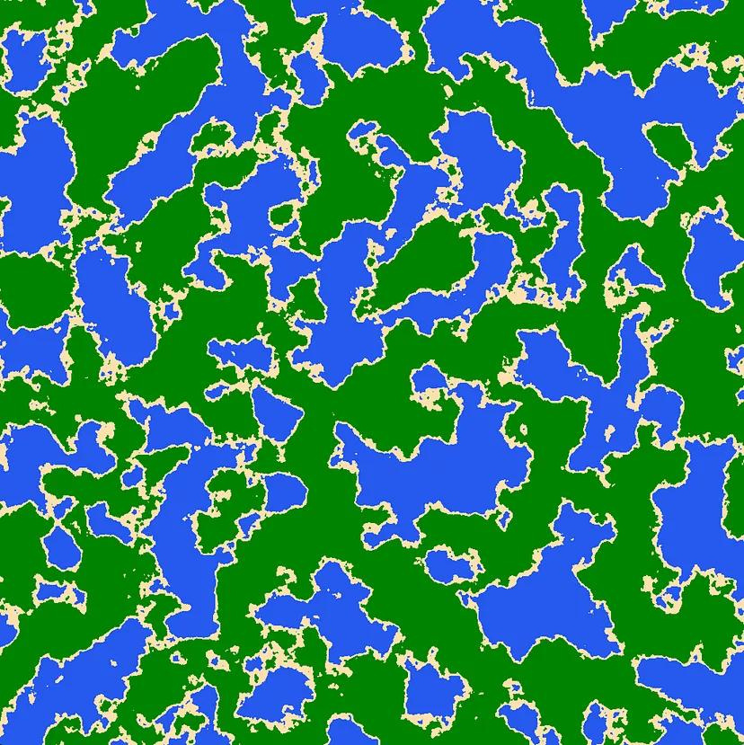
Perlin noise

Slide 8
CELLULAR AUTOMATA
A computational model consisting of a grid of cells where the state of each cell evolves based on the states of its neighbors according to a set of rules.
This method is used in biological systems, generating terrain, and simulating fluid dynamics.
A very basic example of cellular automata
“Conway’s Game Of Life”

Slide 9
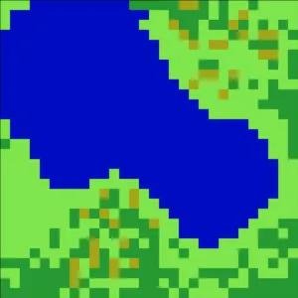
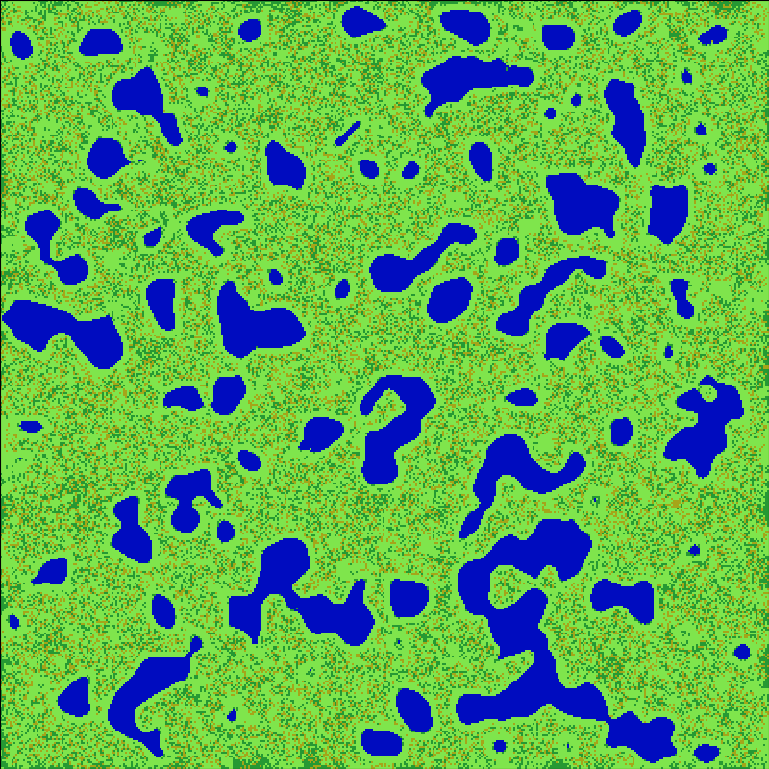

Slide 10
VORONOI DIAGRAMS
Voronoi diagrams can be a useful tool in random world generation, especially for creating diverse and realistic terrain features or distributing resources across the game world.
They are helpful in Terrain generation, Elevation, Vegetation, Biome assignment, World borders
A Voronoi diagram splits divides a space into cells based on a set of points, where each point gets a cell. Each cell consists of all the space closest to the given cell.

Slide 11
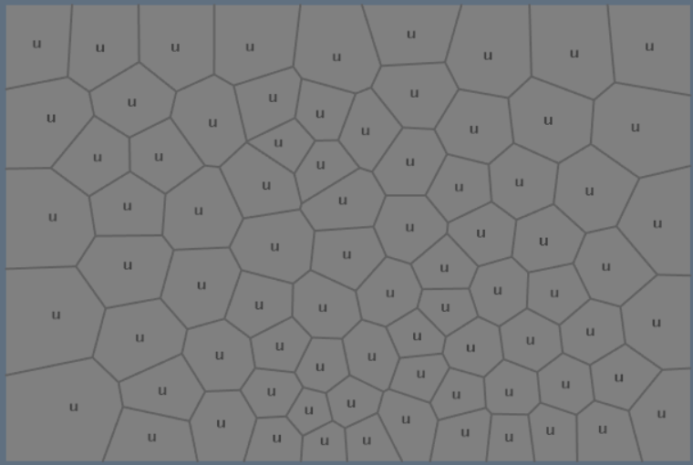
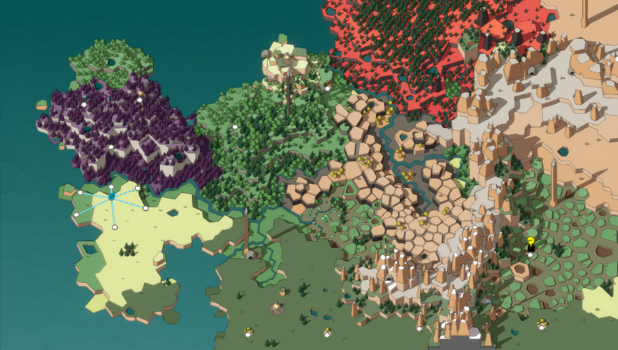
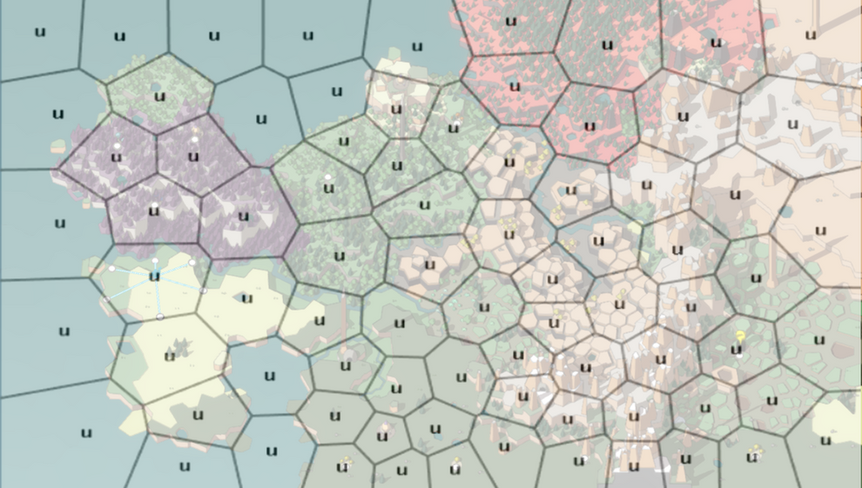

Slide 17
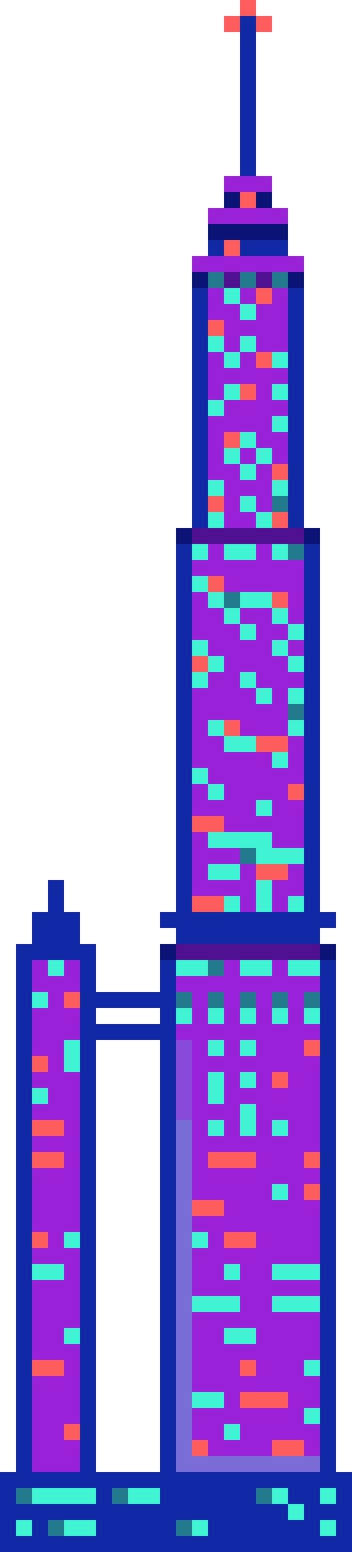
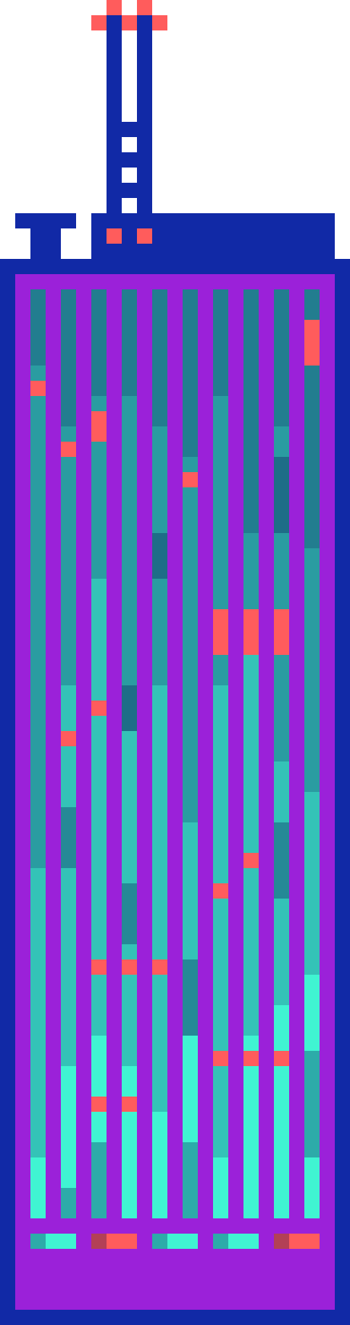
THANK
YOU

